Slide 1
QA Group Project
Kings Casino:
Lottery Draw
Daryl Atienza
James Harder
Gareth Wilson
RPA April 2020
QA Academy Trainees

Slide 2
PROJECT OBJECTIVE:
To design an enterprise use case found commonly within sectors lending themselves to RPA.
Create and Construct a full Design Process Definition (DPD) documentation for the automation.
Create an enterprise-grade project as a team, adhering to the constraints of the project.

Slide 3
Kings Casino:
Lottery Draw
WHAT?
HOW?
WHY?

Slide 4





Slide 5
Documentation...

Slide 6
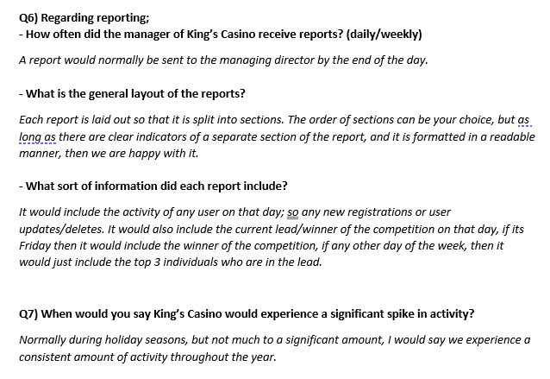
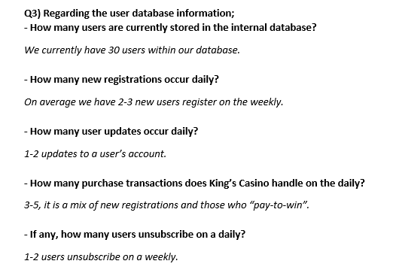
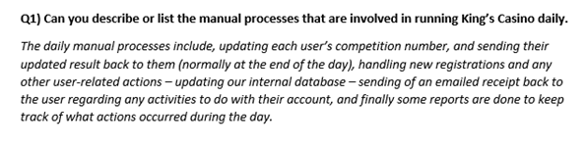
Requirements Gathering
MORE REQUIREMENTS GATHERING IN THE GIT REPOSITORY...

Slide 7
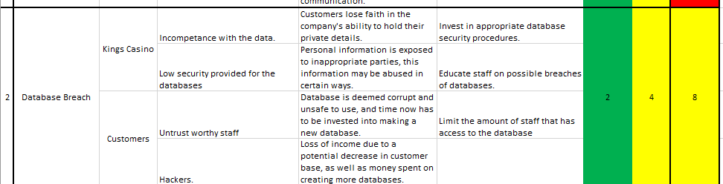
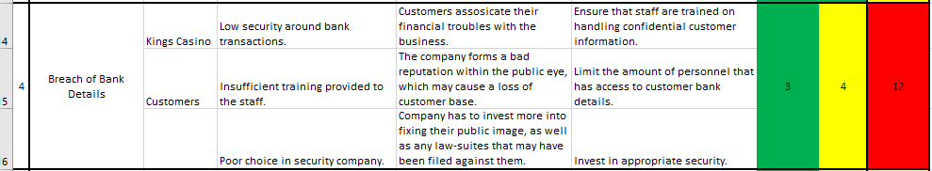
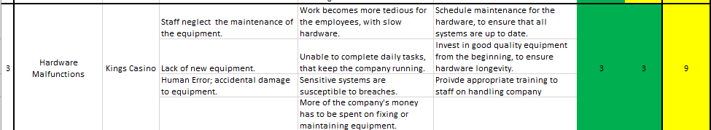
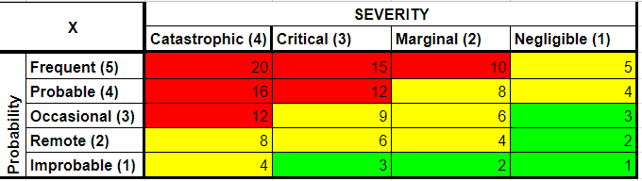
RISK REGISTER
MORE OF THE RISK REGISTER IN THE GIT REPOSITORY...

Slide 8
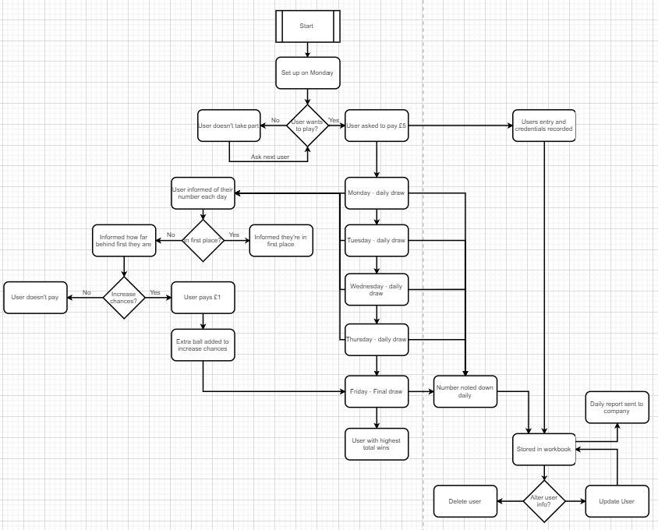
DETAILED PROCESS DESCRIPTION: PROCESS FLOW
Notes:
G

Slide 9
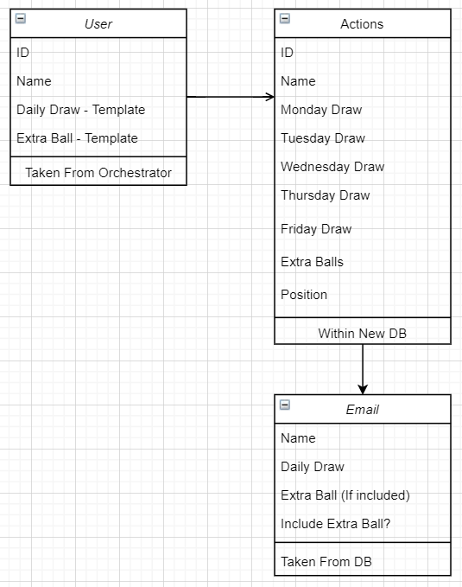
DETAILED PROCESS DESCRIPTION: Actions-Diagram
Notes:
G

Slide 10
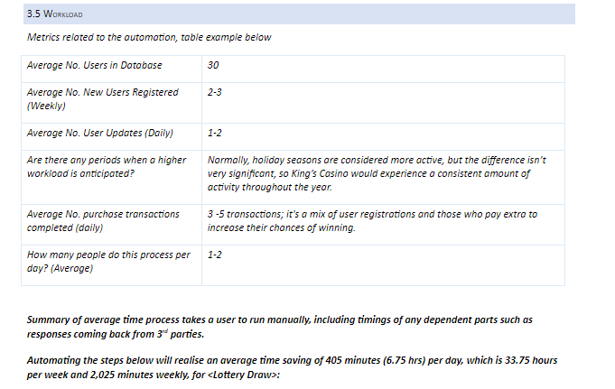
DETAILED PROCESS DESCRIPTION:
Work-Load Overview

Slide 11
Trello and Demonstration . . .

Slide 13
WELCOME BACK

Slide 14
What . Went . Well?
Communication within the Team.
Daily tasks completed in the set time.
Fully working automation with high-grade exception handling.
Documentation conducted at a high level
Deadlines met.
Extensive requirements gathering done.
Informative and organised Trello Board.
Notes:
G

Slide 15
What didn’t go well?
What did we learn from this?
Github/Bash understanding.
Re-framework understanding.
No Global Handler.
Create branches when working on the same process.
Increased knowledge and confidence with Ref-Framework.
Incorporate a Global Handler form the beginning of the project, to handle the exceptions.
Notes:
G

Slide 16
THANK YOU
QUESTIONS?

